Slide 1

Kendrick Street Bicycle Boulevard Final Design
Northern Arizona Transportation Services
Stephen Hirte
Yousef Alkandari
P.J. McKelvey
Christopher Sobie
April 24th, 2015

Slide 2
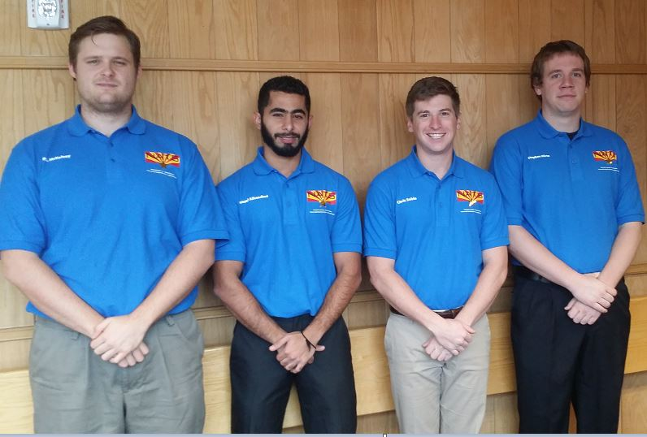
Project Personnel
Alkandari 2
Project Manager – Christopher Sobie
Software Lead – Pierce-Jon McKelvey
Research Lead – Stephen Hirte
Site Lead – Yousef Alkandari
Northern Arizona Transportation Services Team Members [1]

Slide 3
Alkandari 3
Stakeholders
Clients
Jeffrey Bauman, PE, City of Flagstaff Traffic Engineer
Martin Ince, PE, City of Flagstaff Multimodal Planner
Technical Advisor
Jeffrey Bauman, PE, City of Flagstaff Traffic Engineer
Stakeholders
City of Flagstaff - Owner
Local and National Cyclists
Flagstaff High School
Flagstaff Community
Cities who desire a bicycle boulevard

Slide 4
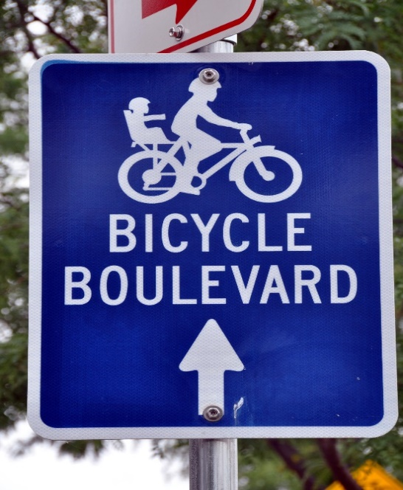
Sobie 4
Project description
Convert Kendrick Street into a Bicycle Boulevard
Improve bicycle safety and circulation by:
Creating low traffic volumes
Discouraging non-local motor vehicle traffic
Provide free flow travel for bicycles
Creating distinctive look or ambiance
Accomplished by:
Equal priority among users
Pavement markings
Eliminating stops
Unique branding
Unique Branding for WI Bike Boulevard [2]

Slide 5
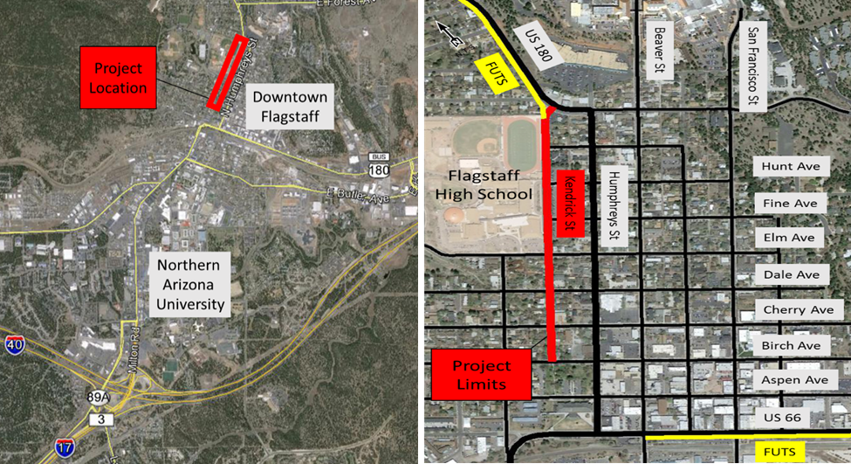
Sobie 5
Project Location
Citywide View [3]
Local View [3]

Slide 6
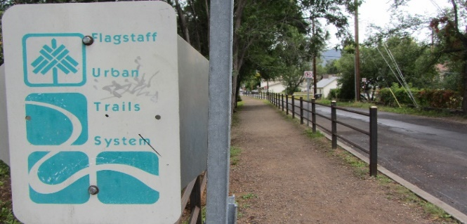
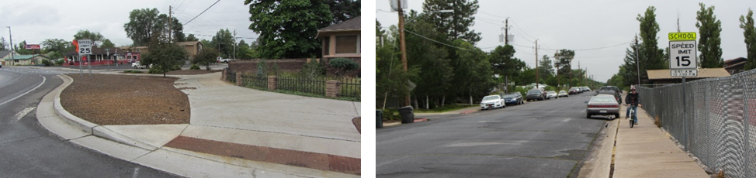
Sobie 6
Existing conditions
FUTS connection
City-wide network of non-motorized shared-use pathways used for recreation and transportation
Unmarked cross-section (37 feet min.)
Street parking
Non-free flow
Moderate to poor pavement condition
FUTS Trail connection on southern end [4]
FUTS Trail Connection on northern end [4]

Slide 7
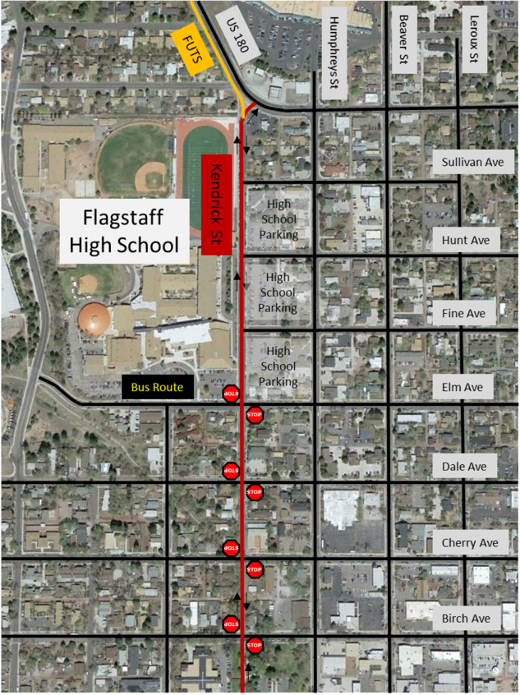
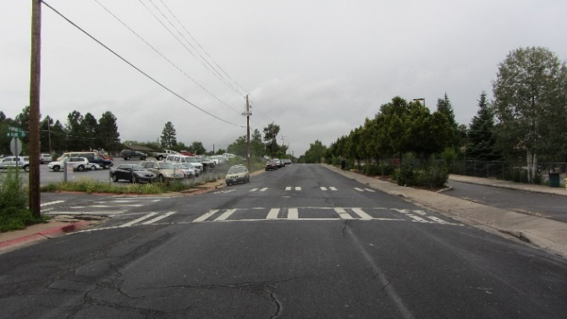
Sobie 7
Existing conditions
Cyclist on sidewalk and random street parking [4]
Karen Cooper Trail
Existing Traffic Control [3]
Typical cross-section of Kendrick Street [4]

Slide 8
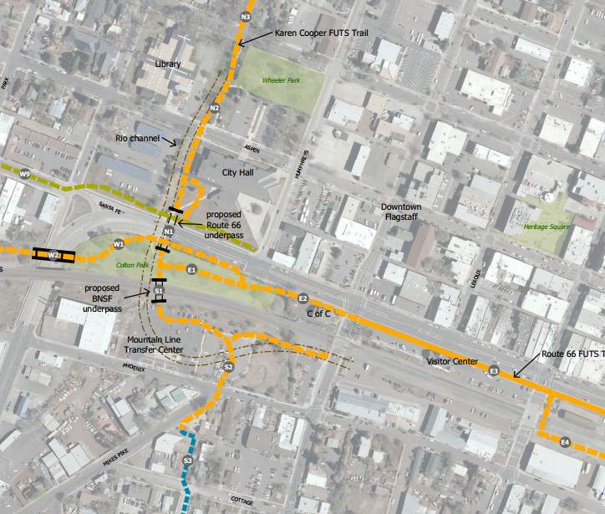
Sobie 8
Future plan for futs trail
Kendrick Street Project Limits
Downtown FUTS Concept Plan [5]

Slide 9
Sobie 9
Project methods
National Association of City Transportation Officials (NACTO)
Bicycle boulevard design elements (nationally)
Route planning, signs and pavement markings, speed and volume management, street crossings, green infrastructure
Manual on Uniform and Traffic Control Devices
AASHTO Geometric Design Guide
National codes and standards for all road components
Arizona Department of Transportation / Flagstaff
Local State and City standards
NACTO Urban Bikeway Design Guide
MUTCD / AASHTO Geometric Design Guide
ADOT Design Manual

Slide 10
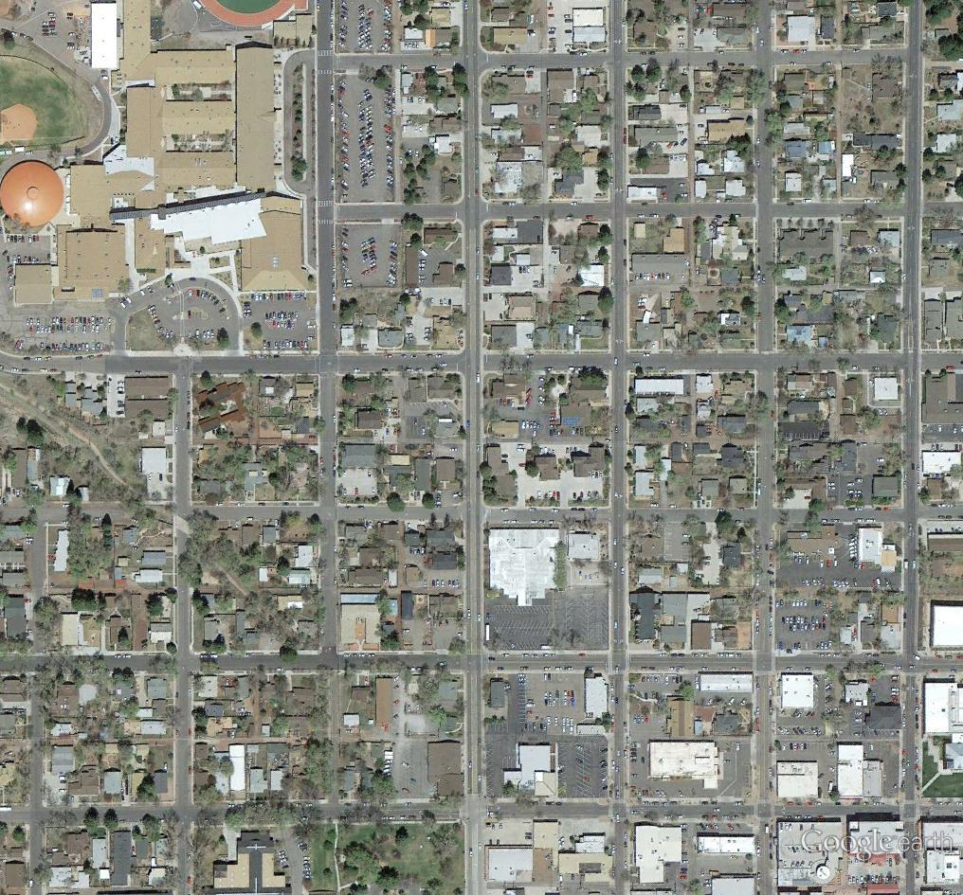
Data Collection/Results – Vehicle Speeds
Hirte 10
Hunt Ave
17 mph
Kendrick St
27 mph
26 mph
Fine Ave
17 mph
26 mph
26 mph
Elm Ave
20 mph
24 mph
Dale Ave
23 mph
22 mph
Cherry Ave
28 mph
22 mph
Birch Ave
85th Percentile Speeds for Vehicle in Project Area [3]

Slide 11
Data Collection/Results – ADT
Hirte 11
207
Hunt Ave
Kendrick St
807
26 mph
Fine Ave
210
818
26 mph
Elm Ave
1515
927
244
258
Dale Ave
232
729
Cherry Ave
1065
647
89
Birch Ave
Average Daily Traffic for Vehicles in Project Area [3]

Slide 12
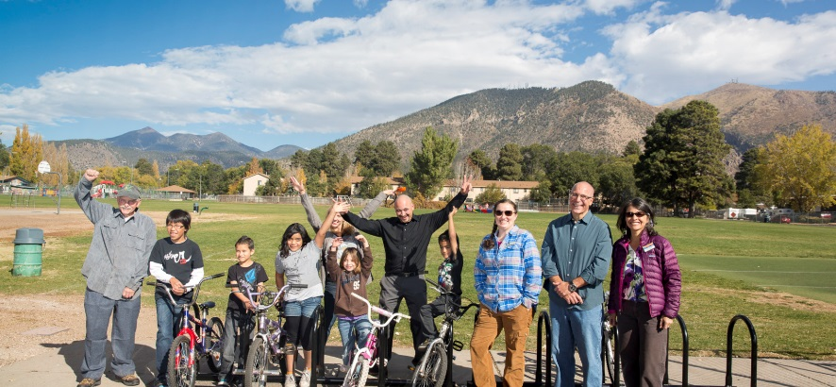
Hirte 12
Community involvement
Community project. Input matters!
9 question survey using SurveyMonkey.com
66 respondents of varying age and riding ability
Hand out fliers to cyclists / windshields
Attend Flagstaff Bicycle Advisory Committee Meetings
Attend Flagstaff Transportation Committee Meeting
Successful Flagstaff Community Bicycling Project [6]

Slide 13
Hirte 13
Survey results

Slide 14
Hirte 14
Survey Comments
Positive Feedback
“As a resident of N Kendrick St. I would like to see a bike boulevard, not only for the safety of bikes but to preserve the street as a non-major alternative thoroughfare to Humphreys. There is a LOT of foot and bike traffic on Kendrick.”
“I encourage any forward progress in improving and promoting bike transportation in flagstaff, regardless if it benefits my route.”
Negative Feedback
“Motorist support for increased/improved bicycle facilities will not increase until bicyclist are taxed to pay for those facilities.”
“Of all the things to spend tax dollars on, are you serious? Help me understand how unequal tax dollar input from cyclists warrants the massive tax dollar output from people driving cars.”

Slide 15
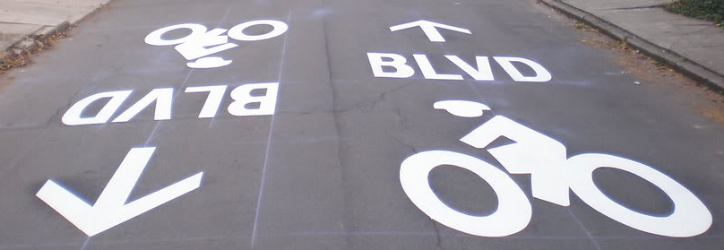
Mckelvey 15
Design constraints and criteria
Minimize implementation costs
Maximize safety
NACTO Recommendations for Bike Boulevards
Less then 3000 ADT
85th Percentile speed of 25 mph or less
Minimize residential impact
Designed for minimum cross-section (37 ft)
Unique marking on Bicycle Boulevard in Columbus, OH [7]

Slide 16
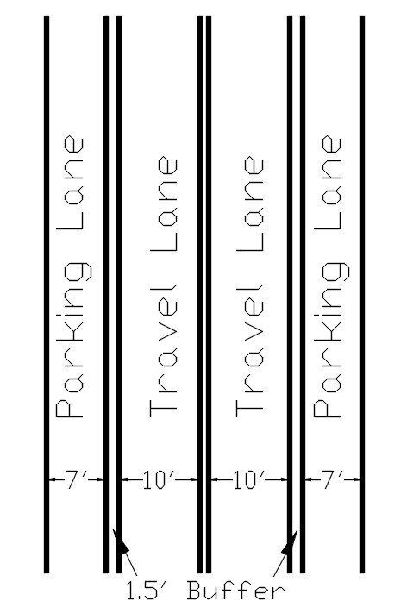
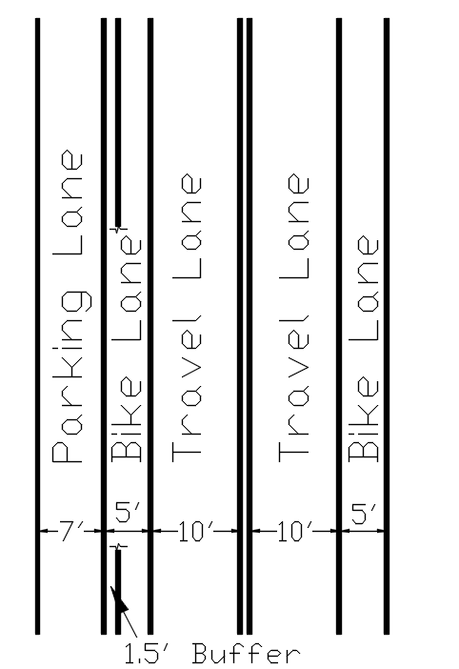
Mckelvey 16
Preliminary alternatives
Alternative 1
Alternative 2
Alternative 1 Drawing [8]
Alternative 2 Drawing [8]
Notes:
Negatives:
Center stripe discourages drivers from passing bicycles (frustration / lack of respect)
More striping = higher cost
Negatives:
Center striping
Discourages Respect
More striping = higher cost
Eliminates parking

Slide 17
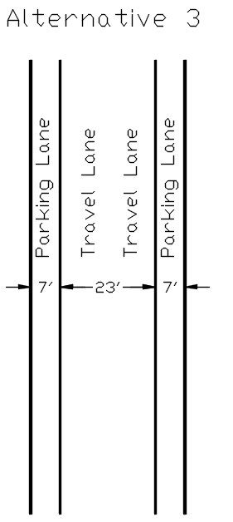
Mckelvey 17
Proposed design
Two 7 ft parking lanes
MUCTD minimum
23 ft travel way
NACTO minimum
No centerline stripe
Preferred by NACTO
Easier time passing
Positives:
Most cost efficient
Inviting to all users
Creates respect among all users
Can use unique pavement markings
Alternative 3
Preferred Alternative Drawing [8]

Slide 18
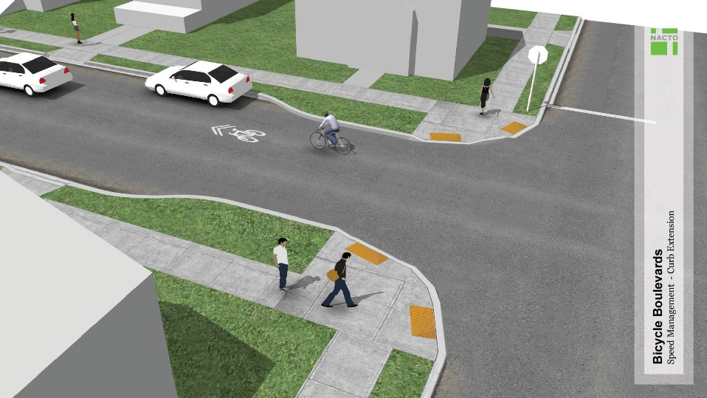
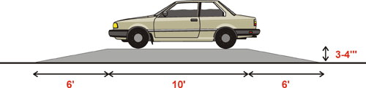
Mckelvey 18
Design elements
Eliminate stop signs along route
Stops increase delay and encourage low compliance
Maintain bicycle boulevard conditions
Eliminate / manage new cut through motorists
Lower traffic speeds and volumes
Bulb-out treatments – narrow travel way
Striping instead of curb and gutter
Addition of crosswalks
25 mph Speed Tables
3 along Kendrick St
Example: Bulb-outs from NACTO Design Guide [9]
Common Speed Table Dimensions [10]

Slide 19
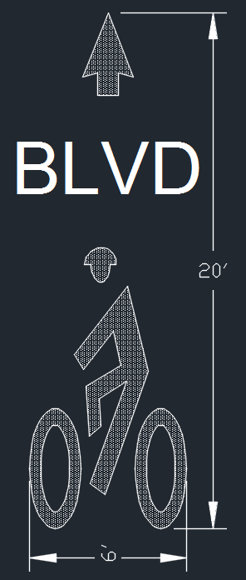

Mckelvey 19
Design elements - wayfinding
Wayfinding, signage, and pavement markings
Provide photographic uniqueness for bicycle boulevard
Differentiate from other local streets
Raise awareness of designation
Prompt motorists to look for cyclists
Unique Kendrick Street Roadway Sign [8]
Kendrick Street Pavement Marking [8]

Slide 20
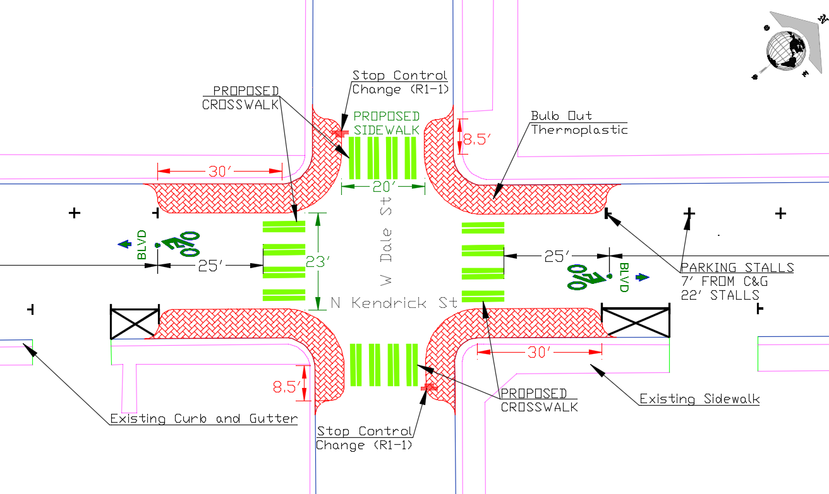
Mckelvey 20
Design elements – geometric
Intersection of Kendrick Street and Dale Street with new crosswalks, pavement markings, and bulb outs. [8]

Slide 21
Alkandari 21
Project hours and costs
Total Project Cost
Items | Units | Unit Cost | Amount | Cost
Parking Striping | LF | $0.70 | 400 | $280
Speed Table | EA | $2,500 | 3 | $7,500
Boulevard Striping | EA | $350 | 23 | $8,050
Thermoplastic | SF | $13 | 1540 | $20,020
Boulevard Signage | EA | $200 | 12 | $2,400
Advance Signage | EA | $200 | 12 | $2,400
Speed Table Signage | EA | $200 | 6 | $1,200
R1-1 Signage Reuse | EA | $100 | 4 | $400
 |  | Implementation Cost |  | $42,000
 |  | Administrative Cost |  | $43,000
 |  | Grand Total |  | $85,000
Project Hours
Christopher Sobie |  |  | 140
Pierce-Jon Mckelvey |  |  | 116
Yousef Alkandari |  |  | 104
Stephen Hirte |  |  | 140
Total hours |  |  | 500
*Costs of implementation _includes materials, _installations, and man _hours.

Slide 22
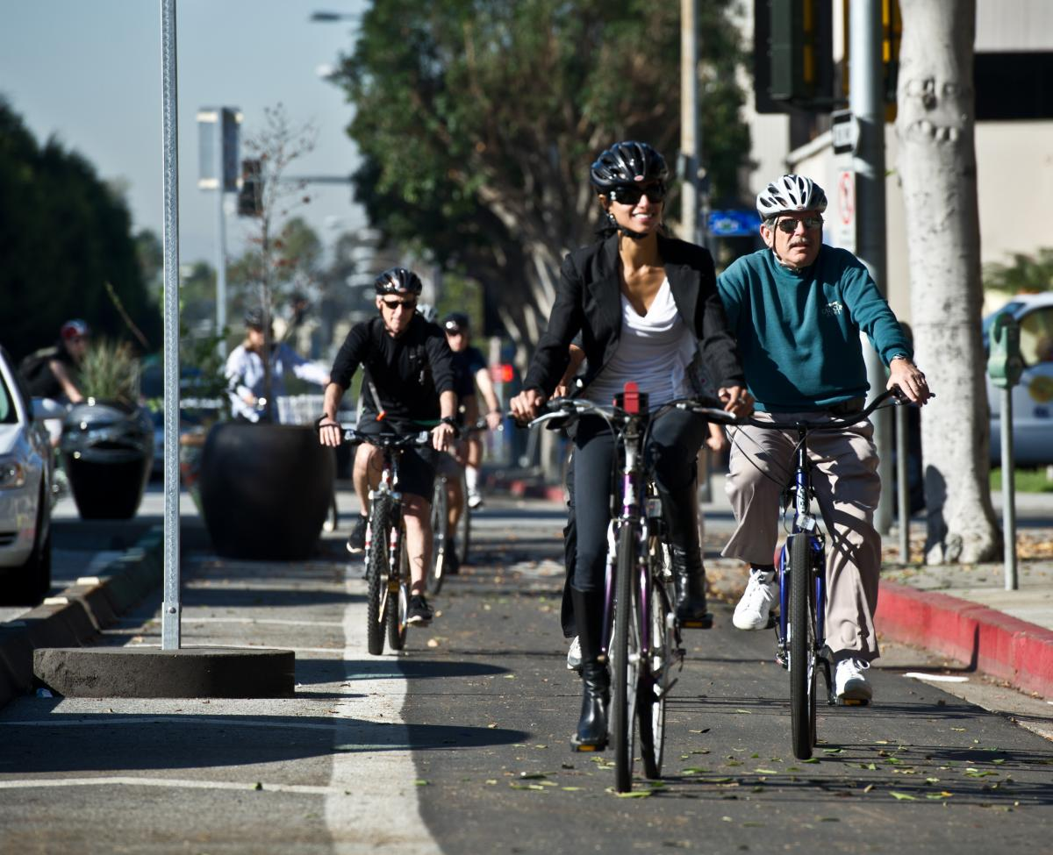
Alkandari 22
Broader impacts of design
Economic
Less pavement rehabilitation
Societal and Cultural
Increased in local cyclists
Aesthetics and community
Environmental
Fewer greenhouse gas emissions
Health
Biking is good exercise
Promotes a healthier community
Global
Paves the way for future bike boulevards nationally and internationally
Cyclists of all levels enjoying bicycle boulevard [7]

Slide 23
Alkandari 23
acknowledgments
Martin Ince, City of Flagstaff Multimodal Planer
Jeff Bauman, City of Flagstaff Traffic Engineer
Logan Couch, City of Flagstaff Traffic Intern
John Koch, Ennis-Flint Traffic Patterns
National Association of City Transportation Officials

Slide 24
Alkandari 23
References
[1] Photo Credit: Katherine Dean
[2] "Review: Wisconsin's First Bicycle Boulevard." Over the Bars in Wisconsin. N.p., 02 Sept. 2010. Web. 10 Mar. 2015.
[3] Google Earth Pro (2011), Version 6.1 (Software), Available from http://www.google.com/enterprise/earthmaps/earthpro.html
[4] Photo Credit: Christopher Sobie
[5] Plan provided by Martin Ince, City of Flagstaff Multimodal Planner
[6] Welcome to an Engaged Community. (n.d.). Retrieved September 18, 2014, from https://az- flagstaff3.civicplus.com/index.aspx?nid=1379
[7] "First Signs of the New Milton Ave. Bike Boulevard!!" ColumbusUnderground.com. N.p., 03 Oct. 2008. Web. 10 Mar. 2015.
[8] AutoCAD Civil 3D. Vers. J.104.0.0. USA: Autodesk, 2014 Project costs
[9] Urban Bikeway Design Guide. New York: National Association of City Transportation Officials, 2012. Print. Final Report
[10] http://www.ladpw.org/Traffic/NTMP/speed-table.gif

Slide 25

Questions?
"Confusing Traffic Signs." A Fun Blog. N.p., 21 July 2014. Web. 10 Mar. 2015.

